Slide 1
ATAI
Advanced Technique of Artificial Intelligence
ATAI
ChongqingUniversity _{AdvancedTechniqueof}
of Technology Artificial Intelligence
Chongqing University of
Technology
Chongqing University ^{ATAI}
_{of Technology} Advanced Techniqueof
Artificial Intelligence
Chongqing University of Technology
Chongqing University of Technology
Residual Denoising Diffusion Models
Code : https://github.com/nachifur/RDDM
—— CVPR’2024
Reported by Yang Jiang
1

Slide 2
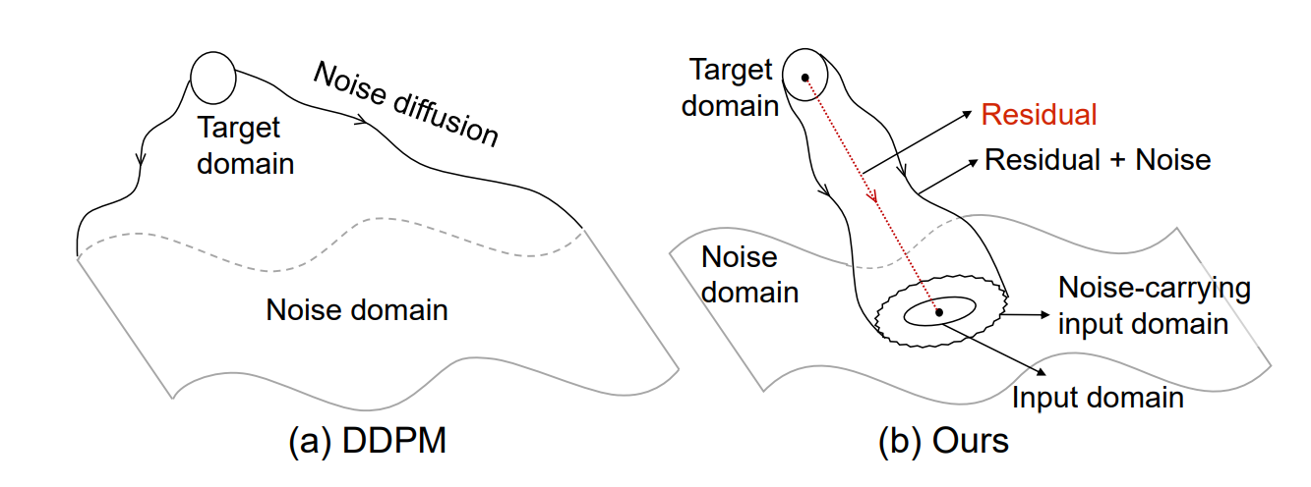
ATAI
Advanced Technique of Artificial Intelligence
ATAI
ChongqingUniversity _{AdvancedTechniqueof}
of Technology Artificial Intelligence
Chongqing University of
Technology
Chongqing University ^{ATAI}
_{of Technology} Advanced Techniqueof
Artificial Intelligence
Chongqing University of Technology
Chongqing University of Technology
Introduction
However, the reverse process starting from noise seems to be unnecessary, as the degraded image is already known. The forward process is non-interpretability for image restoration, as the diffusion process does not contain any information about the degraded image.

Slide 3
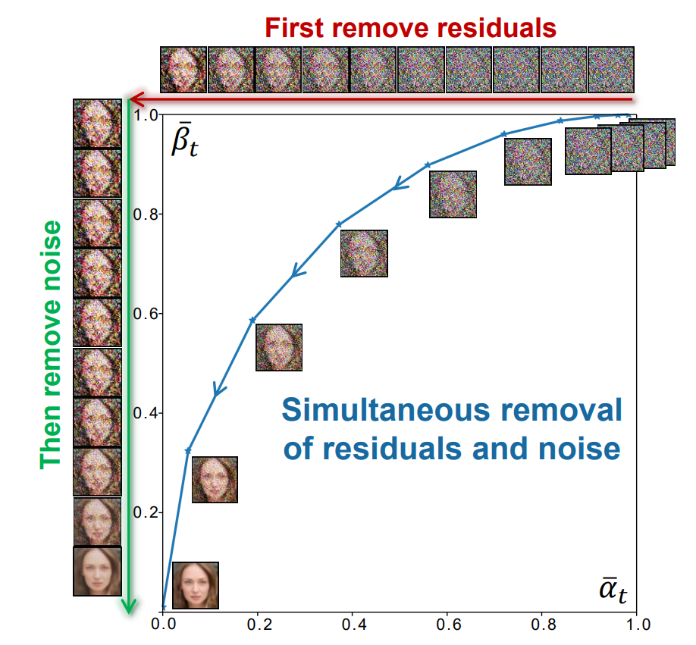
ATAI
Advanced Technique of Artificial Intelligence
ATAI
ChongqingUniversity _{AdvancedTechniqueof}
of Technology Artificial Intelligence
Chongqing University of
Technology
Chongqing University ^{ATAI}
_{of Technology} Advanced Techniqueof
Artificial Intelligence
Chongqing University of Technology
Chongqing University of Technology
Introduction
The previous forward diffusion process is decoupled into residual diffusion and noise diffusion, while in the reverse process, the simultaneous sampling can be decoupled into first removing the residuals and then removing noise.

Slide 4
ATAI
Advanced Technique of Artificial Intelligence
ATAI
ChongqingUniversity _{AdvancedTechniqueof}
of Technology Artificial Intelligence
Chongqing University of
Technology
Chongqing University ^{ATAI}
_{of Technology} Advanced Techniqueof
Artificial Intelligence
Chongqing University of Technology
Chongqing University of Technology
Method
DDPM：
RDDM：

Slide 5
ATAI
Advanced Technique of Artificial Intelligence
ATAI
ChongqingUniversity _{AdvancedTechniqueof}
of Technology Artificial Intelligence
Chongqing University of
Technology
Chongqing University ^{ATAI}
_{of Technology} Advanced Techniqueof
Artificial Intelligence
Chongqing University of Technology
Chongqing University of Technology
Method

Slide 6
ATAI
Advanced Technique of Artificial Intelligence
ATAI
ChongqingUniversity _{AdvancedTechniqueof}
of Technology Artificial Intelligence
Chongqing University of
Technology
Chongqing University ^{ATAI}
_{of Technology} Advanced Techniqueof
Artificial Intelligence
Chongqing University of Technology
Chongqing University of Technology
Method

Slide 7
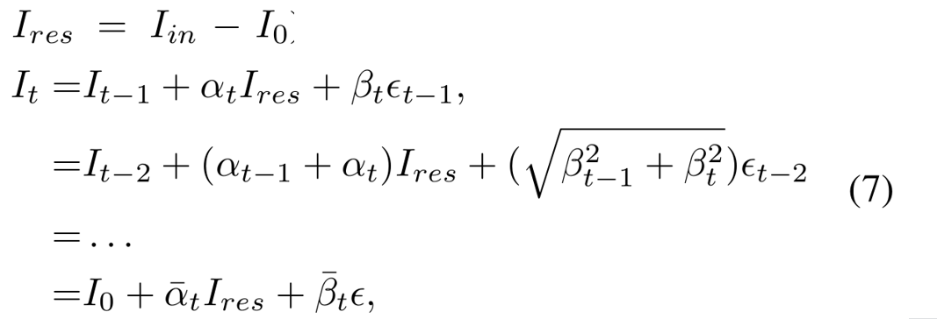
ATAI
Advanced Technique of Artificial Intelligence
ATAI
ChongqingUniversity _{AdvancedTechniqueof}
of Technology Artificial Intelligence
Chongqing University of
Technology
Chongqing University ^{ATAI}
_{of Technology} Advanced Techniqueof
Artificial Intelligence
Chongqing University of Technology
Chongqing University of Technology
Experiments

Slide 8
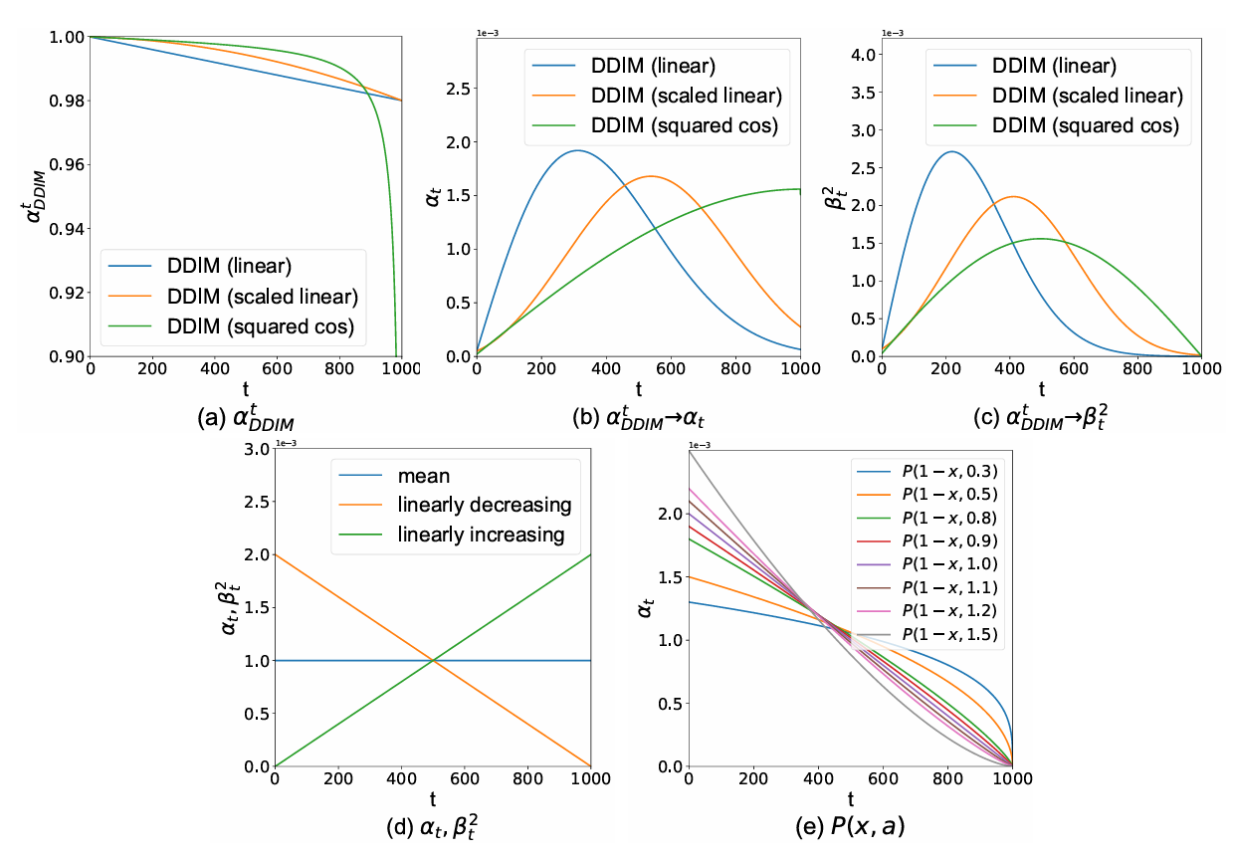
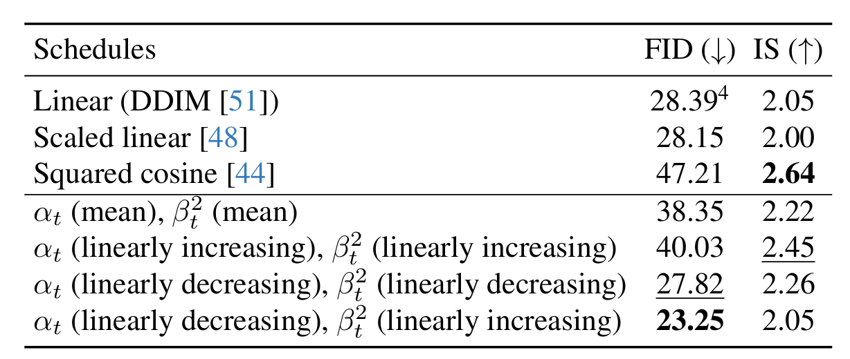
ATAI
Advanced Technique of Artificial Intelligence
ATAI
ChongqingUniversity _{AdvancedTechniqueof}
of Technology Artificial Intelligence
Chongqing University of
Technology
Chongqing University ^{ATAI}
_{of Technology} Advanced Techniqueof
Artificial Intelligence
Chongqing University of Technology
Chongqing University of Technology
Experiments

Slide 9
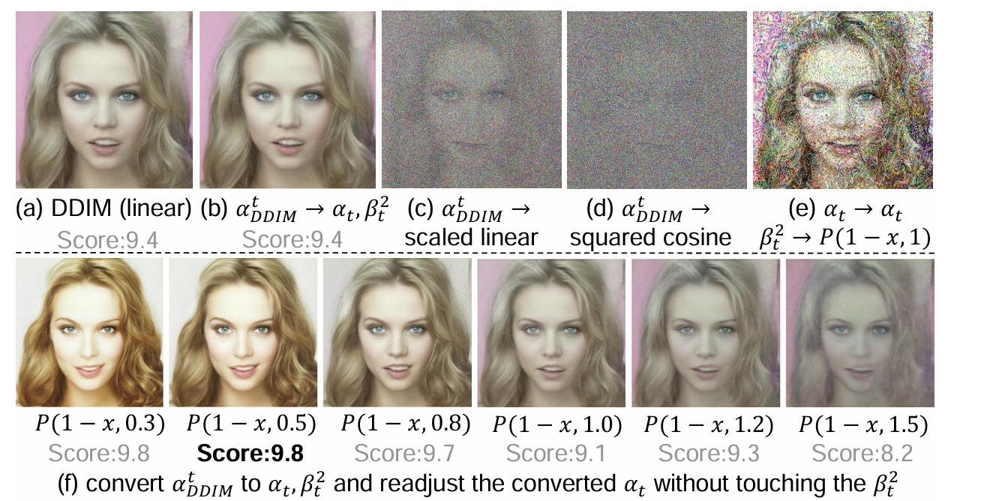
ATAI
Advanced Technique of Artificial Intelligence
ATAI
ChongqingUniversity _{AdvancedTechniqueof}
of Technology Artificial Intelligence
Chongqing University of
Technology
Chongqing University ^{ATAI}
_{of Technology} Advanced Techniqueof
Artificial Intelligence
Chongqing University of Technology
Chongqing University of Technology
Experiments

Slide 10
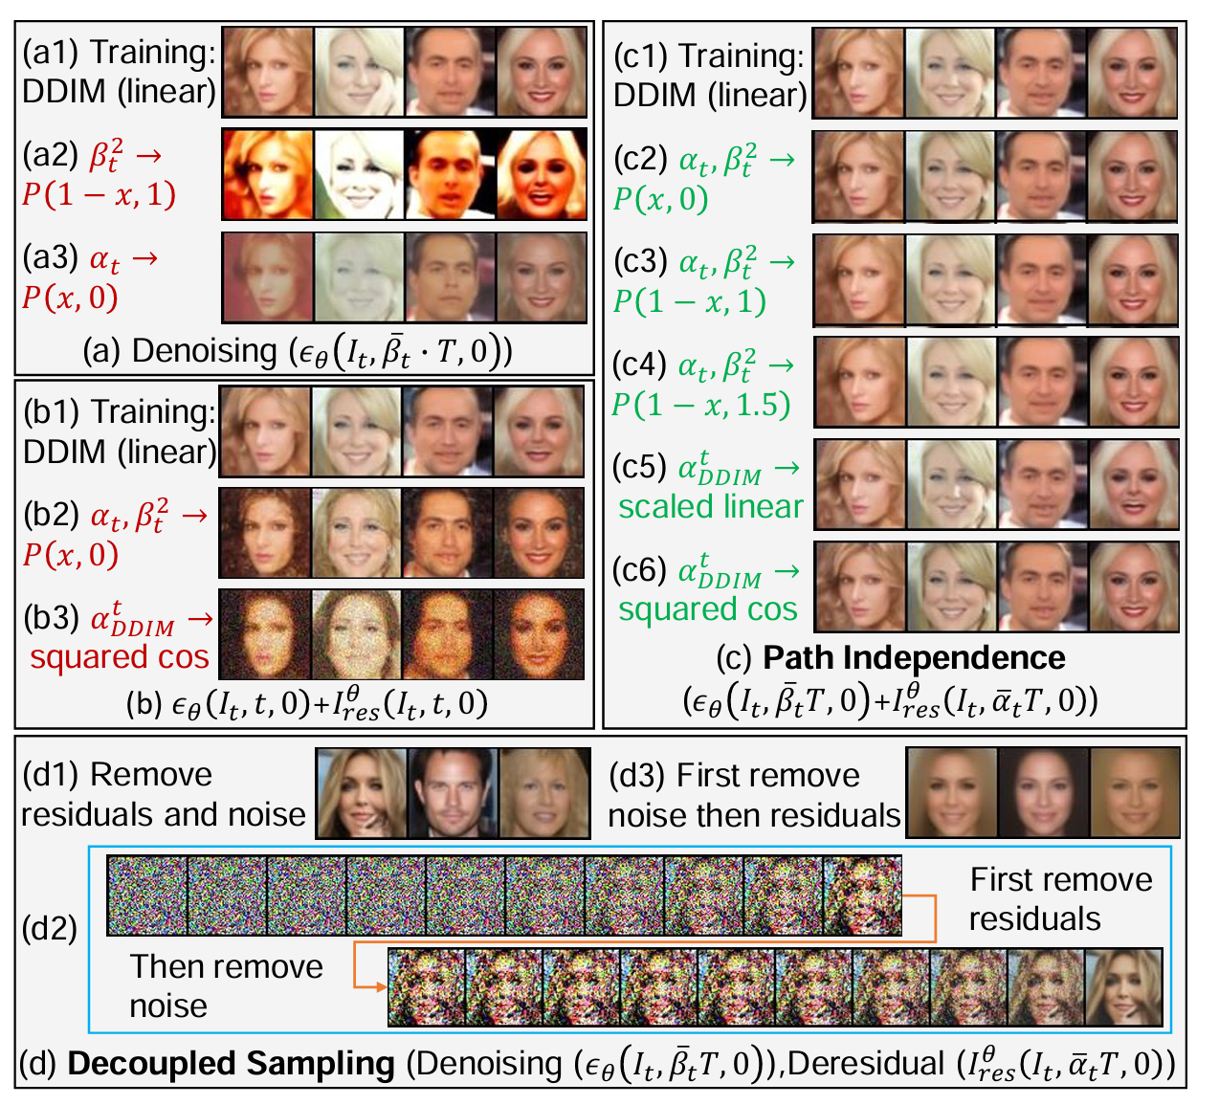
ATAI
Advanced Technique of Artificial Intelligence
ATAI
ChongqingUniversity _{AdvancedTechniqueof}
of Technology Artificial Intelligence
Chongqing University of
Technology
Chongqing University ^{ATAI}
_{of Technology} Advanced Techniqueof
Artificial Intelligence
Chongqing University of Technology
Chongqing University of Technology
Experiments

Slide 11
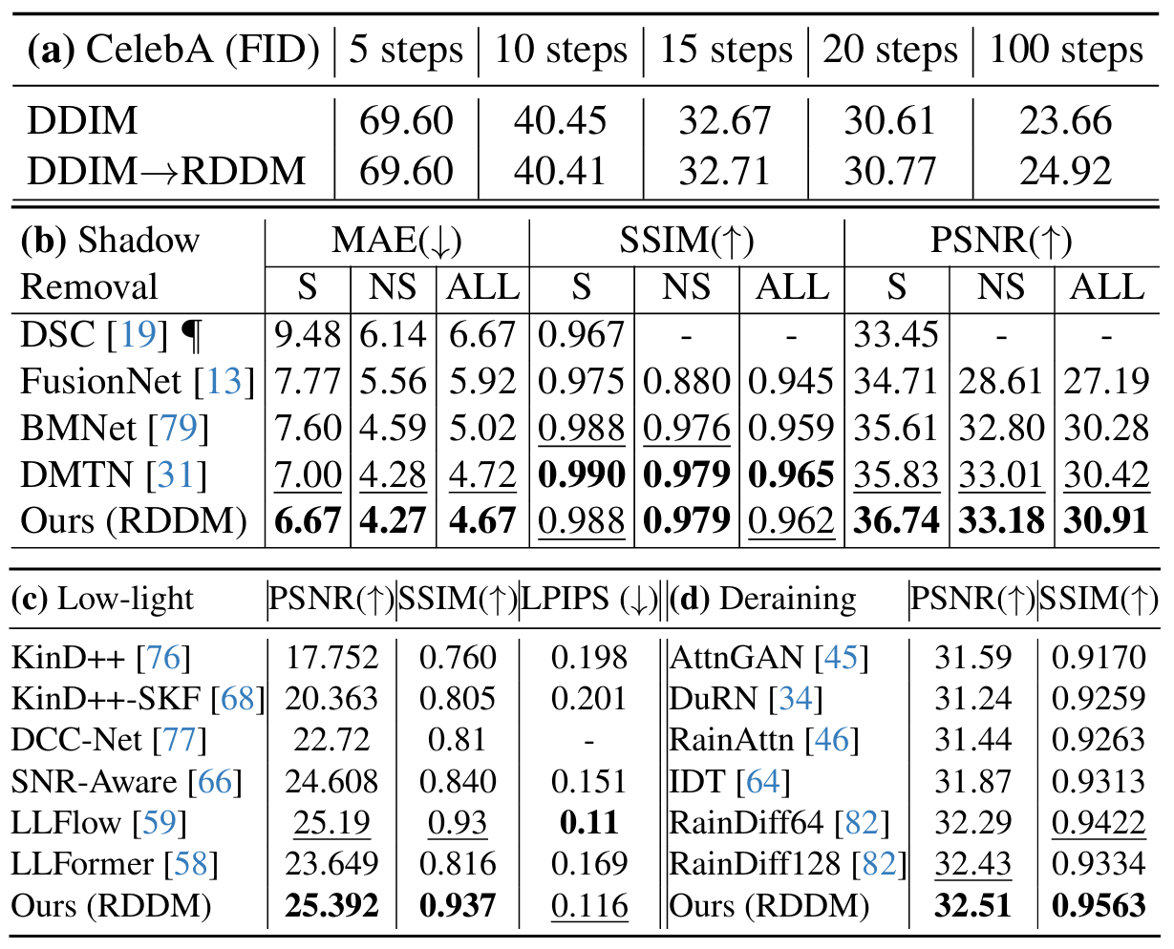
ATAI
Advanced Technique of Artificial Intelligence
ATAI
ChongqingUniversity _{AdvancedTechniqueof}
of Technology Artificial Intelligence
Chongqing University of
Technology
Chongqing University ^{ATAI}
_{of Technology} Advanced Techniqueof
Artificial Intelligence
Chongqing University of Technology
Chongqing University of Technology
Experiments

Slide 12
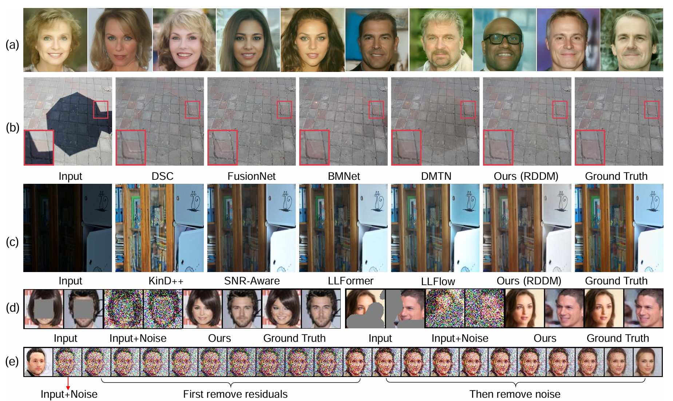
ATAI
Advanced Technique of Artificial Intelligence
ATAI
ChongqingUniversity _{AdvancedTechniqueof}
of Technology Artificial Intelligence
Chongqing University of
Technology
Chongqing University ^{ATAI}
_{of Technology} Advanced Techniqueof
Artificial Intelligence
Chongqing University of Technology
Chongqing University of Technology
Experiments

Slide 13
ATAI
Advanced Technique of Artificial Intelligence
ATAI
ChongqingUniversity _{AdvancedTechniqueof}
of Technology Artificial Intelligence
Chongqing University of
Technology
Chongqing University ^{ATAI}
_{of Technology} Advanced Techniqueof
Artificial Intelligence
Chongqing University of Technology
Chongqing University of Technology
Thanks!

